Slide 1

Step Up/Step Down

Slide 2

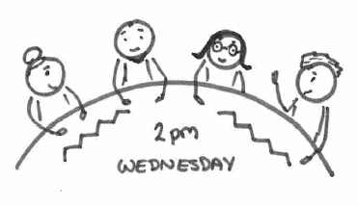



Step Down From C&F Assessment.
Team Manager authorises assessment and agrees decision to step down to Early Help with a clear outline of ‘what needs to happen’.
Team Manager to book onto fortnightly Step Up / Step Down meeting (only if Lead Person not already identified through assessment).
Case discussed at the Step Up / Step Down meeting with clarity of recommendations for well-being plan.
If agreed appropriate then a worker will be allocated the same day. The chair will inform the Social Worker of the outcome within 1 working day.
Within 5 working days of Step Up / Step Down meeting:-
Joint handover visit will be undertaken to the family between Social Worker and Lead Person.
Formal referral to be completed on Liquid Logic.

Slide 3
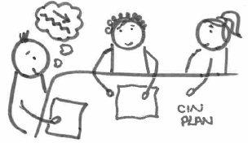

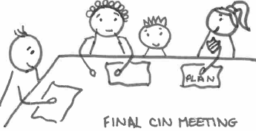
Step Down From CiN Plan.
Decision made that case should step down in the multi-agency Child in Need meeting.
Social Worker supervision confirms decision.
A Lead Person should be identified prior to the final Child in Need meeting.
Social Worker to have discussions with the Family Network and involved professionals regarding Lead Person role.
If no agreement then case discussion to be had at fortnightly Step Up / Step Down meeting. Date of the final CiN meeting shared.
Final Child in Need meeting to be held within 5 days – multi agency agreement that case steps down, with families consent. Referral to be completed on Liquid Logic.
There is an expectation that the identified Lead Person attends the final Child in Need meeting. If not possible then a joint handover visit to take place to the family.

Slide 4



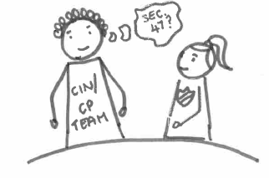

Step Up – Immediate Safeguarding-Led Pathway
Step up outcome
Child in Need/Child Protection team to make a decision regarding S47 (CA ‘89).
C&F assessment to be completed.
Lead Person remains involved whilst assessment is completed and decision made about future intervention.
If assessed as appropriate ChECS will create a referral and pass through to area team within 1 hour.
Open case to Early Help and potential trigger occurs.
Lead Professional refers to ChECS with full details and context of potential incident.

Slide 5
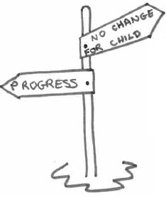
Step Up – Early Help Not Progressing Outcomes Pathway
Children & Family assessment to be completed within 15 days.
Lead Person remains involved whilst assessment is completed and decision made about intervention
If agreed at Step Up / Step Down meeting the referral is made to ChECS, referral created to area team within 24 hours.
Lead Person to discuss with supervisor
Decision made to bring to fortnightly Step Up / Step Down Meeting.
Lead Person has active well-being plan open and can evidence worries regarding lack of case progress.
Early help must have been open for a minimum of 3 months.
Chronology detailing attempts made to engage the family.
Group supervision to have taken place.
Evidence that the family have been advised of the referral to Children’s Services if there is a continued lack of progress (case note or letter to the family as evidenced in the chronology).
Need specific ‘worry statements’ ‘wellbeing goals’ ‘scaling’.

Slide 6
Terms of Reference
Meeting | Step Up Step Down Meeting
Responsible for: | Providing children and families with timely support across levels of need. The step up / step down meeting will be a multi-agency decision making interface to consider cases that need to escalate to Children’s Social care and cases that are looking to step down to early help services. To ensure that no cases are allowed to fall through gaps in services.
Function: | To ensure a smooth transition between levels of need. Ensuring that children and families are clear throughout who is the Lead Person. Consistency of multi-agency planning across levels of need, aiming to ensure the right support at the right time by the right person. To promote partnership engagement and ownership. Opportunity for professional challenge as appropriate. Timely interventions for children and families. The meeting discussion and information sharing will be brief and focused based on the information previously circulated. Individual case discussions should last no longer than 10 minutes but will be dependent on the information available. Identify themes and common issues within the step up and step down process to reduce number of re-referrals.
Accountable to | Safeguarding Partnership.
Chair and Membership | Membership of the group: Service Manager Chair Team Manager ChECS (Deputy chair) Team Manager CIN/CP Cheshire East Family Service Manager Health Representative Education / EYS / SCIES Representative UC; minute taker As necessary an expanded membership can be invited to discuss families with particular needs.
Approach | A meeting will take place in the North and South. The group will meet on a fortnightly basis in each of the two localities (North and South). The meetings in the South will take place in Delamere House. The meeting in the North will take place in Macclesfield Town Hall. The meeting will take place on a Wednesday at 2pm. Documentation required for the meeting to be sent to CIN/CP admin by 4pm on the Wednesday prior to the meeting the following week. Send documentation to AdminCreweCiN&CP@cheshireeast.gov.uk for cases open to Crewe CiN/CP or MacclesfieldCIN&CPAdmin@cheshireeast.gov.uk for cases open to Macclesfield CiN/CP. The agenda will be circulated via email by 12 noon on the Friday prior to the next meeting for each respective locality areas. Apologies should be sent to the chair ASAP although, where actions were identified within the minutes, written feedback will be required. The chair can give a summary of the discussion so that outcomes have a clear rationale. The chair will document the outcome so that there is a record of the decisions made on the child’s record. Business support will circulate the outcomes to members within 2 working days of the meeting. Members will filter outcomes to appropriate workforce within their service. Any disagreements regarding a decision made by the group should be reported to the chair and escalated through each services management structure until a resolution is agreed upon.
Performance Measures | Feedback to be sought from children and families about their experiences of intervention across levels of need. Expectation that there will be a reduction in the re-referral rates. 3 monthly reports will be provided considering effectiveness and impact.
Date of last review of TOR ____________
Signed _____________________________________ Date____________

