Slide 1
James and Josie’s
Words and Pictures
TRAINING EXAMPLE
Names have been changed to protect identities

Slide 2
This has been written by Helen and mum to explain to James and Josie what has happened and what people are worried about.
Notes:
This is a Cheshire East case

Slide 3
When mum was in her 20’s she met and fell in love with James’ dad.
After a while mum became pregnant with James and she was so excited to meet her first child
Notes:
This is a Cheshire East case

Slide 4
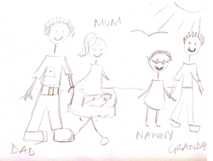
Mum says that at that time there were lots of people around who loved James and spent time taking him out and enjoying families holidays together, sometimes with mum and dad and sometimes Nanny and Grandad.
Notes:
Include some positives as well for balance

Slide 5
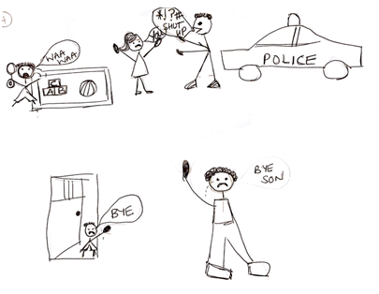
When James was still very little, things became hard between mum and dad and they started arguing a lot, so much so that the Police went to the house because it got worrying. In the end, mum and dad decided they couldn’t stay together anymore so dad left and James stayed with mum.

Slide 6

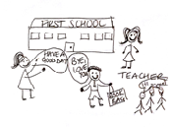
It was just James and mum for a long time and mum says there were lots of good times with Nanny and Grandad.
When James started school he looked so smart in his uniform and he loved learning and seeing all of his pals.

Slide 7
When James was 8 years old Nanny and Grandad moved to a different country and that was sad for James and mum, and difficult because they had been a really big part of the family

Slide 8
Because of everything that had been happening, James started finding it difficult at school. School didn’t know how to help him so he moved schools, but he kept on being asked to leave.

Slide 9
Mum met dad Paul then and he became a big part of the family. At first it was good to have another adult in the home to help mum and James.

Slide 10
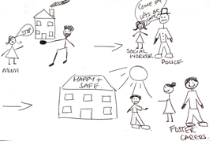
When James was 9 the Police and Social Workers found out that Dad Paul was hurting mum and James saw some of that. People were so worried that he went to live with Bill and Jenny (foster carers) for 3 months. They loved having James with them for a while.

Slide 11
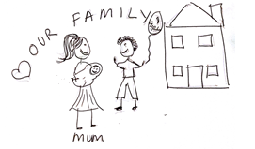
In 2014 Josie was born. Mum was so happy and James was too. He was so protective, and still is, of Josie. Josie really looks up to her big brother.

Slide 12
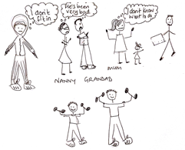
Because there have been lots of difficult times for everyone in the family, some people are not talking to each other (like Nanny and Grandad not talking to James) and others are not allowed to see people (like Dad Paul not visiting Josie and James not seeing his Dad).
What mum and Helen are worried about is that James has seen so many of these difficult things like losing his dad, his grandparents and friends from school it’s made it hard for him to know where he belongs and manage how he feels sometimes.

Slide 13
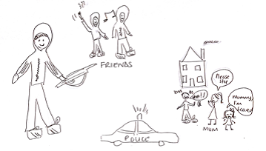
Mum and Helen have been worried about James being out of school and spending time with people who take and sell drugs. They worry that he will get hurt or in serious trouble, like when the Police arrested him for smashing up the home.
Josie gets scared when things like this happen, seeing her big brother so angry that he’s hurting her mum and the house.

Slide 14
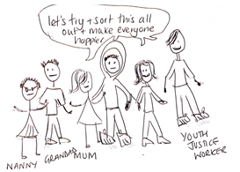
Mum, Helen, Youth Justice, Nanny and Grandad are all going to work together with James and Josie to figure out how everybody can get what they need, like James getting his math and English, and Josie, James and mum living in their home where they all feel safe.

